Slide 1

INTRODUCTION TO AI (AI101B) Even Semester Session 2025-26
ROCK-PAPER-SCISSOR GAME
Tushar Chandra Pant , Tushar Mishra , Shresth Yadav , Utkarsh Sanre
Project Supervisor:
Supervisor Name: Ms. Komal Salgotra
Designation: Assistant Professor

Slide 2
Introduction to Rock-Paper-Scissors
Game Basics
Programming Concepts
Project Aim
Rock-Paper-Scissors is a simple game with three choices: rock, paper, and scissors. Rock crushes scissors, scissors cut paper, and paper covers rock.
The game introduces key programming concepts such as conditional statements, loops, functions, and random number generation.
This project develops a Python-based game where a player competes against a computer, with the computer's choice randomly generated.

Slide 3
Objective of the Project
Develop a Python-based Tic-Tac-Toe game.
Implement AI-driven opponent strategy to create an engaging experience.
Ensure modular and scalable code for future enhancements.
Provide an interactive and user-friendly interface.
Introduce basic AI decision-making within a game setting.

Slide 4
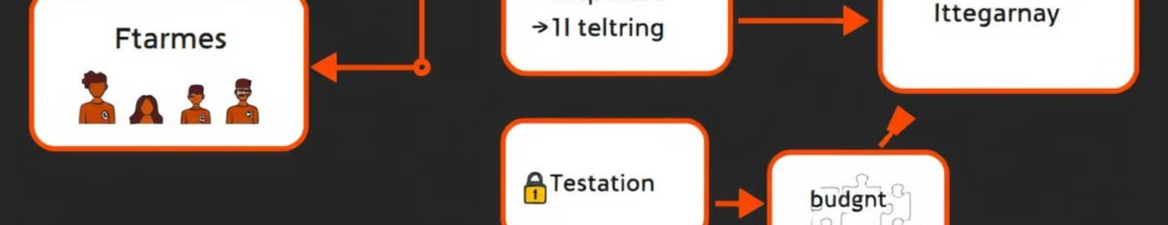
Methodology: A Modular Approach
Structured Programming
Four Major Steps
Future Enhancements
The game logic is divided into multiple functions, ensuring clarity, maintainability, and scalability.
The implementation consists of generating computer choice, handling user input, determining the winner, and executing the game.
This approach allows for easy debugging and potential upgrades such as multi-round gameplay or a GUI.

Slide 5
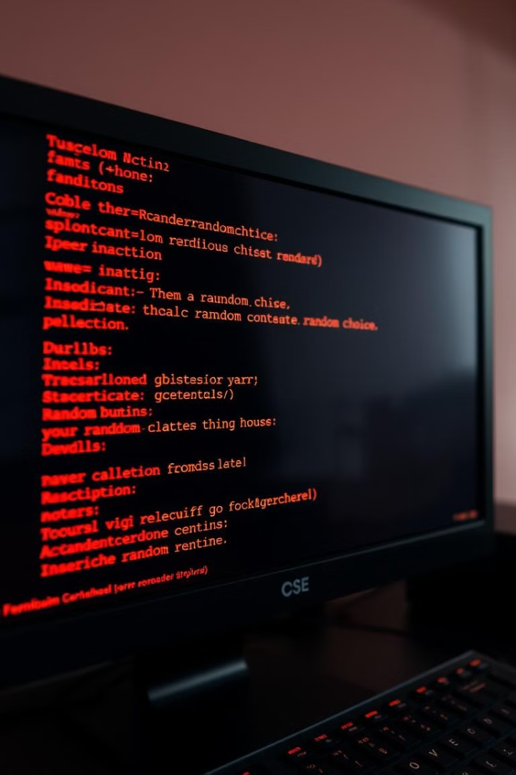



Generating Computer Choice
Random Module
Unbiased Selection
AI-Driven Decisions
The get_computer_choice() function uses Python's random module to select a random option from a predefined list.
The use of randomness guarantees that the computer's selection is unbiased and unpredictable.
Future enhancements could involve AI-driven decision-making, where the computer learns from previous rounds.

Slide 6
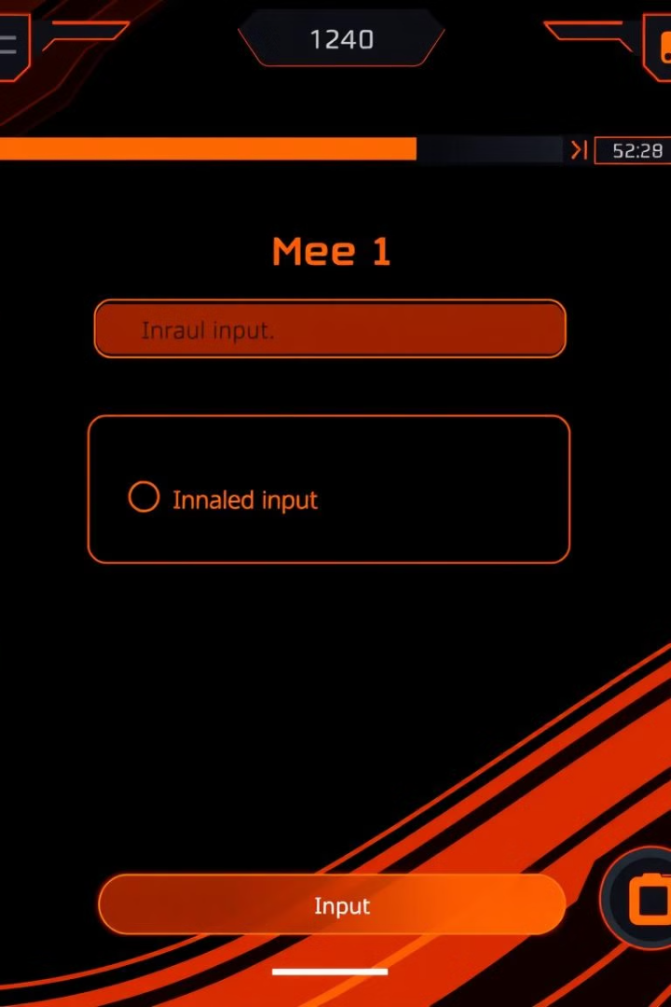



Handling User Input
Input Validation
The get_player_choice() function takes user input and validates it using a while loop.
Error Messages
If the user enters an invalid choice, they receive a friendly error message and are prompted to try again.
User Experience
This mechanism enhances user experience and prevents unintended errors that could disrupt gameplay.

Slide 7



Determining the Winner
Tie Condition
2
If both choices are the same, the game results in a tie.
Game Rules
1
Rock crushes Scissors, Scissors cut Paper, Paper covers Rock.
If-Elif-Else
A series of if-elif-else statements evaluate the player's choice against the computer's choice.
3

Slide 8




Conclusion and Future Improvements
Successful Implementation
Possible Improvements
The Rock-Paper-Scissors game was successfully implemented using Python.
Implementing multiple rounds with score tracking and adding a GUI could enhance the game.
Learning Tool
This project serves as a learning tool for beginners, introducing key programming concepts.

